Slide 1
Automatic Assessment of Answers to Mathematical Drawing Questions
Diunuge Buddhika Wijesinghe
Supervisors: Dr. Surangika Ranathunga, Prof. Gihan Dias

Slide 2
Introduction
O/L Exam is a major turning point of life
40%-50% Students fail Mathematics
O/L Mathematics is identified as a subject which needs “Special Attention” by Ministry of Education
“Making Mathematics a favorite Subject” is a educational goal of 2013 (Annual performance report, 2013, Ministry of Education)

Slide 3
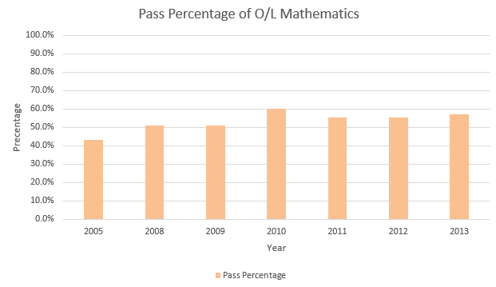
Pass Percentage of O/L Mathematics

Slide 4
Practicing for exam is important!
Manual marking capacity of teachers is limited
An automatic grading system capable of providing quick feedback on practice exam answers is important
Required to have a good feedback system to evaluate student answers
Diagram Grading is not significantly addressed
Notes:
Practicing for an exam is one of the main things to be successful in exams. Students who sit for major examinations such as GCE Ordinary Level in Sri Lanka should practice for exams using past papers. When practicing it is required to have a good feedback system to evaluate student answers. Since manual marking capacity of teachers is limited, an automatic grading system capable of providing quick feedback on practice exam answers would be highly useful [1], both to students and teachers. Currently, auto grading is somewhat limited to MCQ answers since evaluating MCQ answers are pretty much straight forward.

Slide 5
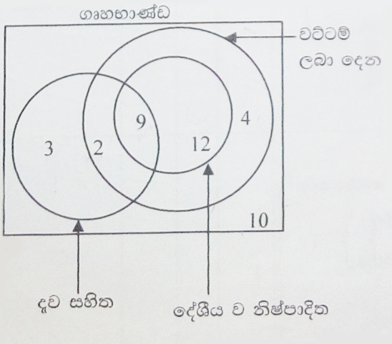
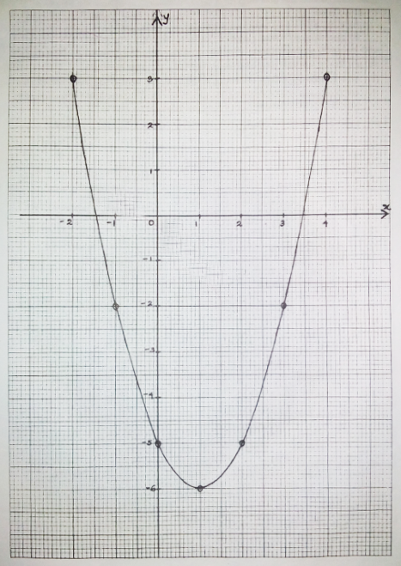
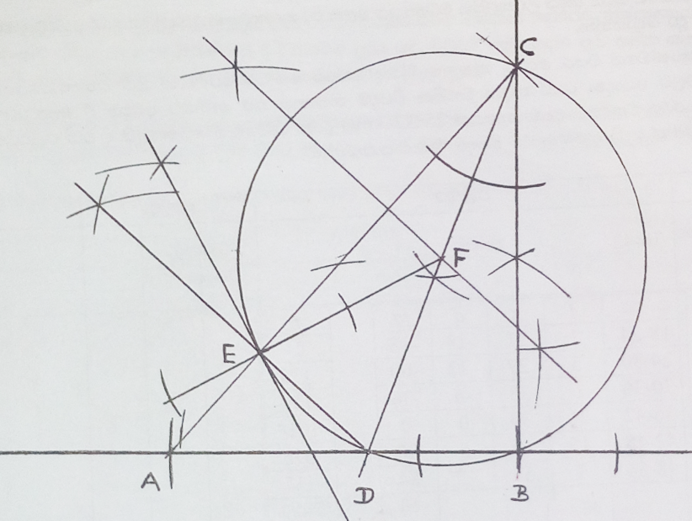
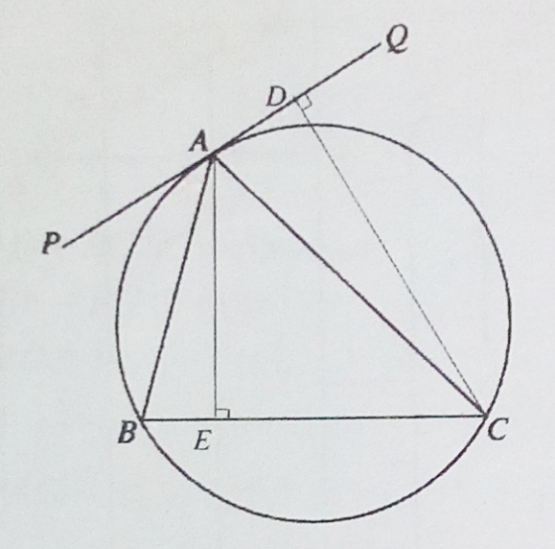
Diagrams in the O/L Mathematics Paper
Cartesian Graphs
Venn Diagrams
Geometrical Drawings
Trigonometry Drawings
Notes:
Histograms
Custom drawings

Slide 6
Objectives
Identify and parse diagrams which provided as answers in O/L mathematics
Evaluate the given answers with respect to marking scheme
Provide feedback to the student

Slide 7
Research Scope
Parse Mathematical Drawings appearing in O/L context which are Vector Images (SVG)
Venn Diagrams
Cartesian Graphs
Geometrical Drawings
Develop Automatic Evaluation Method for above diagrams
Develop a Feedback System
Notes:
Talk about Full system in brief

Slide 8
Work done so far
Diagram Assessment modules developed for the Venn diagrams and the Cartesian diagrams
Diagram Type | Parsing | Assessment & Feedback
Venn | Completed | Completed
Cartesian | Completed | Started, Not Completed
Geometric | Not Started | Not Started

Slide 9
Work done up to the Review 1
Found the research problem
Background study of the research problem in general
Literature Review of Venn Diagrams
Venn Diagram Parsing
Developed a XML structure to represent Venn information
Diagram Type | Parsing | Evaluation & Feedback
Venn | Completed | Not Started
Cartesian | Not Started | Not Started
Geometric | Not Started | Not Started

Slide 10
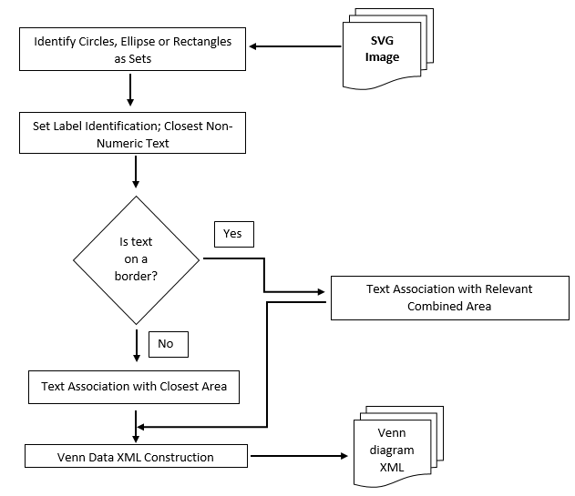
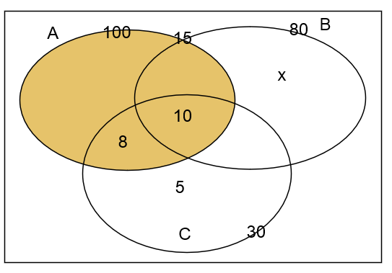
Work done up to the Review 1 Contd.
Venn Diagram Parsing
Sets represented using Rectangles, circles and Ellipse

Slide 11
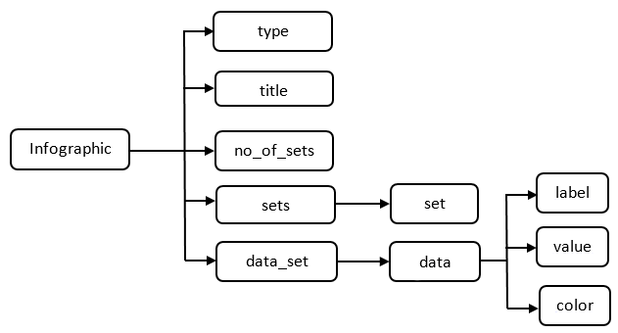
Work done up to the Review 1 Contd.
Venn Data Structure
Venn Diagram in SVG file format

Slide 12
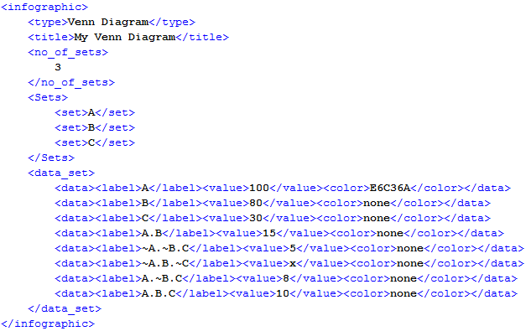
Work done up to the Review 1 Contd.
Venn Diagram after parsing
Venn Diagram in SVG file format

Slide 13
Work done up to the Review 2
Improved Venn Diagram Parsing
Handled Venn Diagrams with Multiple elements per a minimal region.
Handled Diagrams labeled using arrows.
Venn Diagram Assessment
Developed a rubric structure to capture the marking scheme given in exams.
Identified the marking requirements in the O/L exam by studying the marking schemes.
Completed the assessment module.
Diagram Type | Parsing | Evaluation & Feedback
Venn | Completed | Completed
Cartesian | Completed | Started, Not Completed
Geometric | Not Started | Not Started

Slide 14
Work done up to the Review 2 Contd.
A paper on Venn Diagram Interpretation has been accepted to the 16th IEEE International Conference of Advances in ICT for Emerging Regions (ICTer2016)
Paper will be presented in September 2016

Slide 15
Work done up to the Review 2 Contd.
Cartesian Diagram Parsing
Developed the rubric structure to capture required information
Developed the heuristic algorithms needed for the parsing
Completed the parser
Cartesian Diagram Assessment
Identified the marking requirements in the O/L exam
Developed a rubric structure to model the marking scheme
Completed the assessment module.
Diagram Type | Parsing | Evaluation & Feedback
Venn | Completed | Completed
Cartesian | Completed | Started, Not Completed
Geometric | Not Started | Not Started

Slide 16
Venn Diagram Assessment

Slide 17
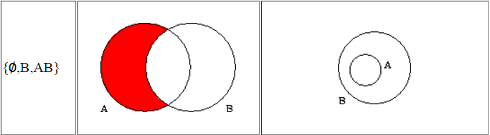
Literature Review
“Survey of Euler Diagrams”(2014)[1] and “Survey of Venn Diagrams”(1997)[2]
Discussed the theory related to Venn and Euler Diagrams including definitions, representations and similarity.
Generalization and similarity measures of Venn and Euler Diagrams
Notes:
P. A. Rodgers, “A survey of Euler diagrams,” Journal of Visual Languages & Computing, vol 25(3), pp.134-155, 2014.
F. Ruskey and M. Weston, “A survey of Venn diagrams,” Electronic Journal of Combinatorics, Vol 4(3), 1997

Slide 18
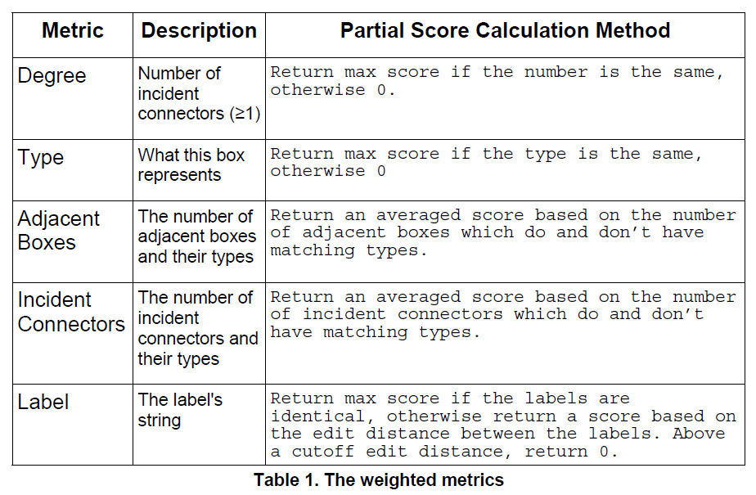
Literature Review: Marking Methods
Tselonis et al (2005)[3] discussed a marking method based on marking matrices for graph-based diagrams.
Notes:
C.Tselonis, J. Sargeant, and M. M. Wood, "Diagram matching for human-computer collaborative assessment," Proceedings of the 9th CAA Conference, 2005.
Discussed for graph based drawings, diagrams consisting of boxes joined by connectors

Slide 19
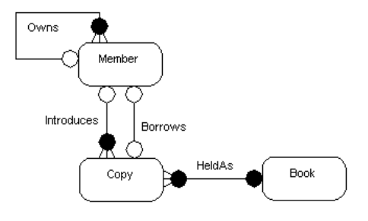
Literature Review: Marking Methods Contd.
Thomas et al (2006, 2005)[4, 5] also developed a marking method based on “Minimal Meaningful Units” for graph-based diagrams.
Minimal Meaningful Units is two nodes with a relationship in a graph and
Notes:
Thomas, Pete, Kevin Waugh, and Neil Smith, "Using patterns in the automatic marking of ER-diagrams,“ ACM SIGCSE Bulletin, Vol 38(3), 2006.
P. Thomas, K. Waugh, and N. Smith, "Experiments in the automatic marking of ER-diagrams," ACM SIGCSE Bulletin, Vol 37(3), pp. 158-162, 2005.

Slide 20
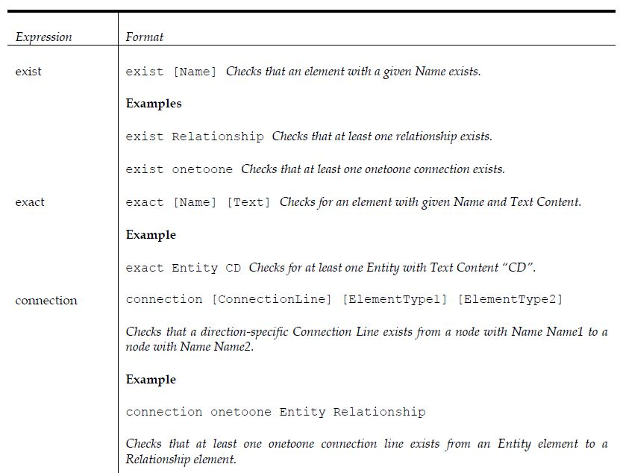
Literature Review: Marking Methods Contd.
Bligh et al (2006)[6] discussed the marking method and developed a grammar for E-R diagrams.
Notes:
B. Bligh and C. A. Higgins, "Formative computer based assessment in diagram based domains." ACM SIGCSE Bulletin, Vol 38(3), pp. 98-102, 2006
Loughborough Univresity

Slide 21
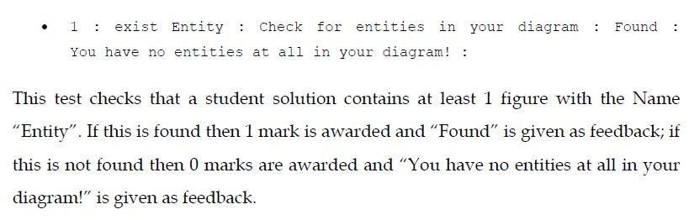
Literature Review: Marking Methods Contd.
Bligh et al (2006)[6] discussed the marking method and developed a grammar for E-R diagrams.
Notes:
B. Bligh and C. A. Higgins, "Formative computer based assessment in diagram based domains." ACM SIGCSE Bulletin, Vol 38(3), pp. 98-102, 2006
Loughborough Univresity

Slide 22
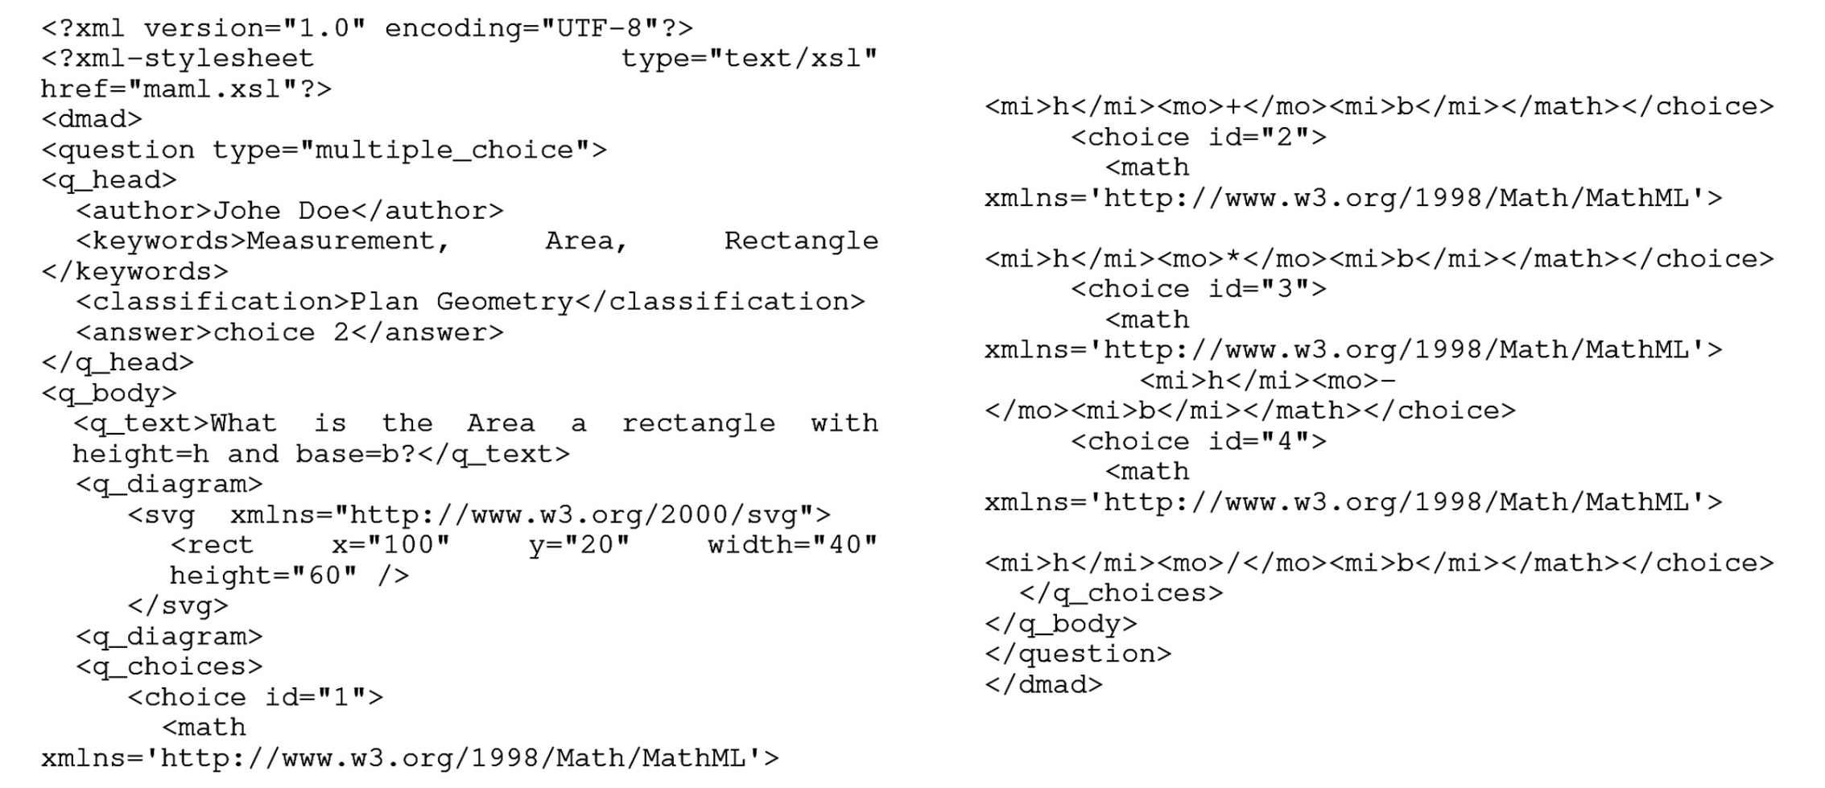
Literature Review: Marking Rubrics
Li et al (2006)[7] developed a language for mathematical problem representation called Mathematics Assessment Markup Language (MAML), using XML, MathML and SVG.
Notes:
G. Li, W. Su, Y. Zhao, and L. Li, "Design and implementation of MAML," in Proceedings of ATCM, 2006.

Slide 23
Literature Review: Marking Rubrics Contd.
Richard et al (2008)[8] presented a way of representing a rubric document in a machine understandable format using XML (U.S. Patent Application)
D. Ambekar (2015)[9] discussed a rubric structure suitable essay assessment.
None of above rubrics are directly applicable to model marking scheme in diagram grading of O/L mathematics.
So, we developed our own, using the research above
Notes:
R. F. Boehme, P. G. Fairweather, U. Farooq, D. Lam and K. Singley, "Method, apparatus and computer program code for automation of assessment using rubrics," U.S. Patent Application No. 10/722,926, 2008
D. Ambekar, “Evaluation of essays using incremental training for Maximizing Human-Machine agreement“, Indian Institute of Technology, Bombay, 2015.

Slide 24
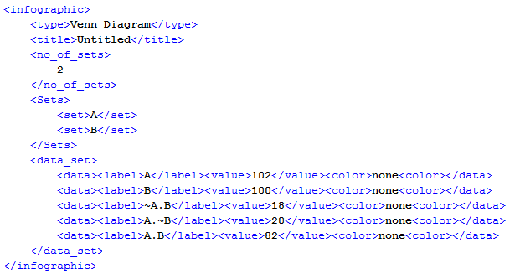
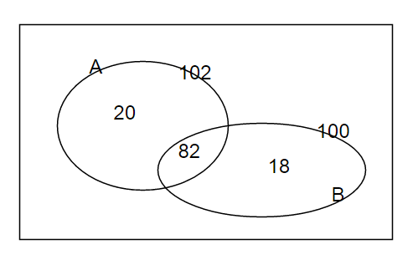
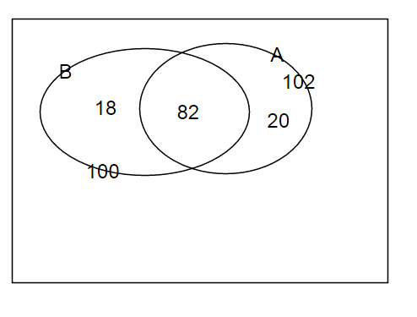
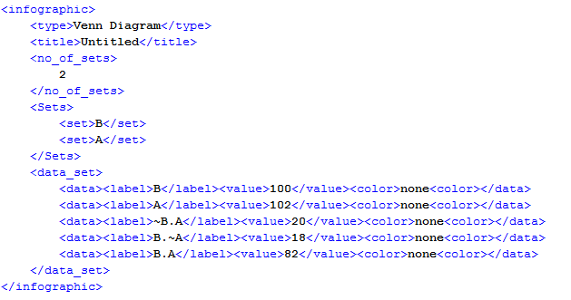
Venn Similarity
Two answers for O/L Venn Diagram Question in 2000
Notes:
We can do one to one matching

Slide 25
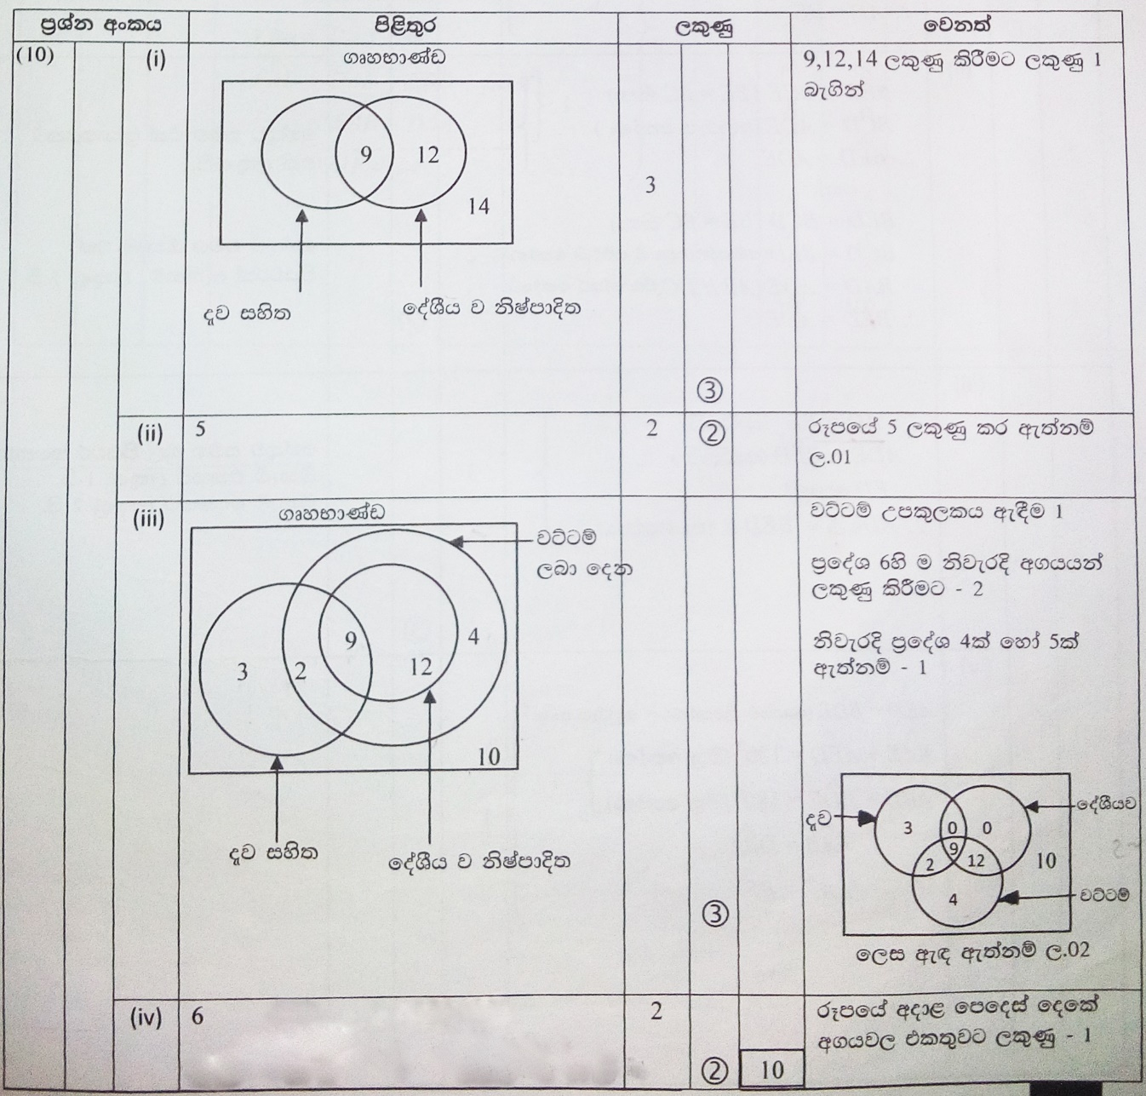
Marking Scheme
Marking scheme integration
Marking criteria depends on the question
General patterns
One to one match
Required compulsory details
Required optional details
Partial marks
Alternative diagrams

Slide 26
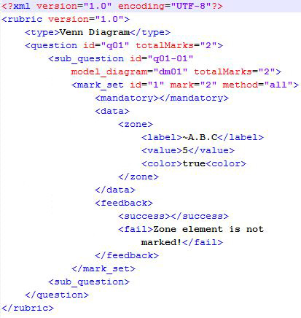
Rubric Model
Able to model all O/L marking methods
Sub-questions can have different marking methods
Optional feedback section that can entered by the teacher

Slide 27
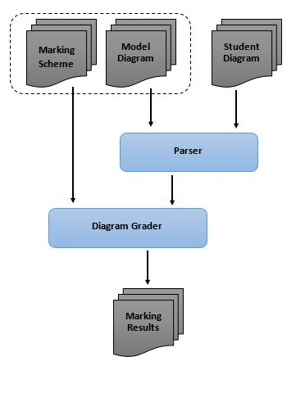
Assessment System
Check for set structure
Checked for mandatory requirements
Match sets in student diagram to model diagram
Evaluate mark-sets
Calculate highest mark

Slide 28
Evaluation Results
Collected diagram from 10th grade exam from a school
19 of 21 students answered the Venn diagram question
Collected diagram from undergraduates & postgraduates
58 diagrams
Diagram No. | Diagram Type | Total Diagrams | Correctly Marked against manual assessment | Accuracy
1 | Venn | 19 | 18 | 94.7%
2 | Venn | 12 | 12 | 100%
3 | Euler | 11 | 11 | 100%
4 | Euler | 11 | 11 | 100%
5 | Euler | 5 | 4 | 80.0%
6 | Euler | 8 | 7 | 87.5%
7 | Venn | 11 | 10 | 90.9%

Slide 29
Cartesian Diagram Assessment

Slide 30
Systems that handled Cartesian diagrams
Huang and Tan(2008,2007,2005)[14,15,16] proposed a model-based approach for recognizing several commonly used types of chart image
System is developed to handle raster images
Textual Information Extraction is introduced with machine learning approach
Introduced a grammar for chart images
Only for chart types such as line charts, bar charts
Discussed application of the system
Notes:
W. Huang, C. Tan, and W. K. Leow, “Associating text and graphics for scientific chart understanding,” In Document Analysis and Recognition, in Proceedings of the Eighth International Conference on IEEE, 2005, pp. 580-584.
W. Huang and C. Tan, “A System for Understanding Imaged Infographics and Its Applications,” in Proceedings of the 2007 ACM symposium on Document engineering - DocEng '07, 2007.
Weihua Huang, "Scientific chart image recognition and interpretation," PhD diss., 2008.

Slide 31
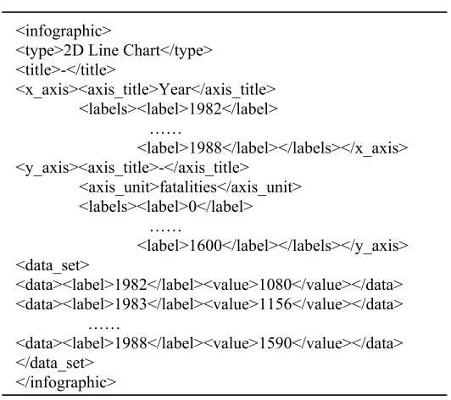
Systems that handled Cartesian diagrams Contd.
XML structure proposed by Huang et al.
Notes:
W. Huang, C. Tan, and W. K. Leow, “Associating text and graphics for scientific chart understanding,” In Document Analysis and Recognition, in Proceedings of the Eighth International Conference on IEEE, 2005, pp. 580-584.
W. Huang and C. Tan, “A System for Understanding Imaged Infographics and Its Applications,” in Proceedings of the 2007 ACM symposium on Document engineering - DocEng '07, 2007.
Weihua Huang, "Scientific chart image recognition and interpretation," PhD diss., 2008.

Slide 32
Systems that handled Cartesian diagrams Contd.
Futrelle et al.(1992,1995)[17,18] presented a diagram understanding system based on graphics constraint grammars to recognize x-y data graphs and gene diagrams
Biological Knowledge Laboratory, Northeastern University
Handled Raster Images
Proposed a constraint based grammar for parsing
Discussed efficient parsing of graphs
Spatial Indexing for efficient parsing
Experimented for x-y graphs

Slide 33
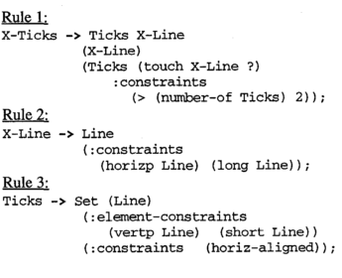
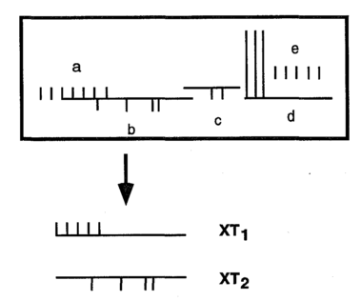
Literature Review Contd.
A diagram with 24 lines in the a-e portion which yields two X-Tick structures, XT1 and XT2. according to the grammar

Slide 34
Cartesian Diagram in O/L Context
Used to represent liner equations
Contains quadratic equations
Regular type of question
Required to draw on a given graph sheet
Assessment focuses on the scale, data points and the shape of the graph

Slide 35
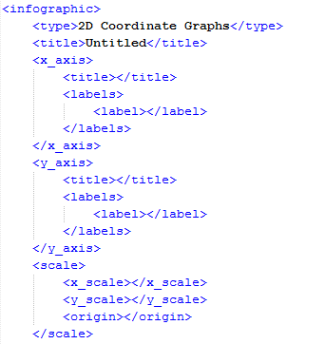
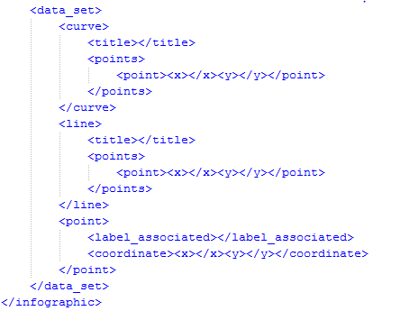
Cartesian Diagram XML Model

Slide 36
Cartesian Diagram Parser
Workflow
Classify components
Identify the axis
Find the origin
Mapping the Scale
Identify Points (Small filled circles)
Associate point labels
Parse Quadratic path
Identify linear paths (If any)
Build XML
Notes:
Very short vertical lines…. Tan>10( , tan<0.1)

Slide 37
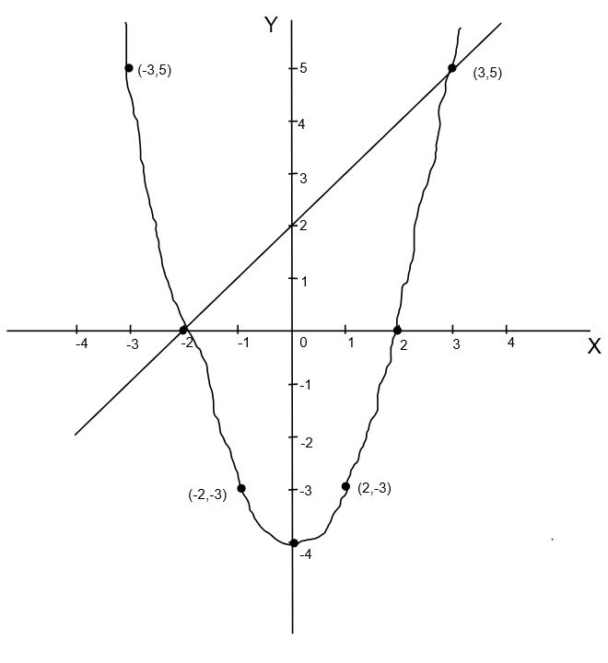
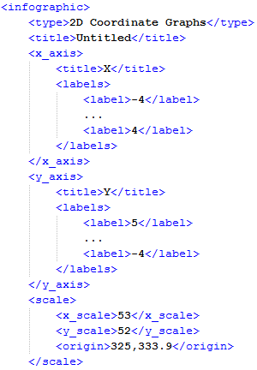
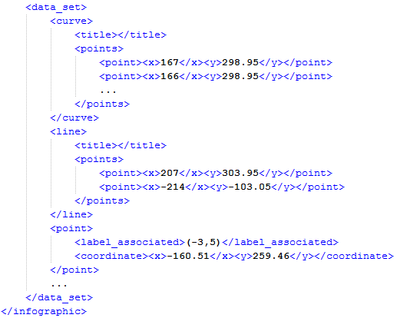
Cartesian Diagram Parser Contd.

Slide 38
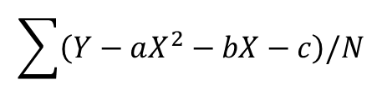
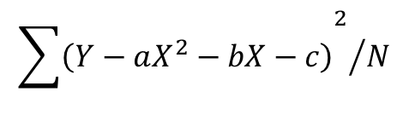
Cartesian Diagram Grader
Workflow
Check for the Scale
Evaluate for Quadratic equation
Check for valid points from Identified points (At least 5)
Check for the equation divergence(curve shape)
Evaluate for Linear equation
Check for valid points from Identified points (At least 2)
Check for the equation divergence(Tan.)
$$\sum{\left(Y−aX^{2}−bX−c\right)/N}$$
$${{\sum{\left(Y−aX^{2}−bX−c\right)}}^{2}}/N$$

Slide 39
Work to be done
Improve Diagram Parsing
Marking Scheme integration to the Cartesian Diagram Evaluation
Parsing and Evaluation of remaining diagram type
Geometric Drawings
Diagram Type | Parsing | Evaluation & Feedback
Venn | Completed | Completed
Cartesian | Completed | Started, Not Completed
Geometric | Not Started | Not Started

Slide 40
References
P. A. Rodgers, “A survey of Euler diagrams,” Journal of Visual Languages & Computing, vol 25(3), pp.134-155, 2014.
F. Ruskey and M. Weston, “A survey of Venn diagrams,” Electronic Journal of Combinatorics, Vol 4(3), 1997.
C.Tselonis, J. Sargeant, and M. M. Wood, "Diagram matching for human-computer collaborative assessment," Proceedings of the 9th CAA Conference, 2005.
Thomas, Pete, Kevin Waugh, and Neil Smith, "Using patterns in the automatic marking of ER-diagrams,“ ACM SIGCSE Bulletin, Vol 38(3), 2006.

Slide 41
References
P. Thomas, K. Waugh, and N. Smith, "Experiments in the automatic marking of ER-diagrams," ACM SIGCSE Bulletin, Vol 37(3), pp. 158-162, 2005.
B. Bligh and C. A. Higgins, "Formative computer based assessment in diagram based domains." ACM SIGCSE Bulletin, Vol 38(3), pp. 98-102, 2006
G. Li, W. Su, Y. Zhao, and L. Li, "Design and implementation of MAML," in Proceedings of ATCM, 2006.
R. F. Boehme, P. G. Fairweather, U. Farooq, D. Lam and K. Singley, "Method, apparatus and computer program code for automation of assessment using rubrics," U.S. Patent Application No. 10/722,926, 2008

Slide 42
References
D. Ambekar, “Evaluation of essays using incremental training for Maximizing Human-Machine agreement“, Indian Institute of Technology, Bombay, 2015.
W. Huang, C. Tan, and W. K. Leow, “Associating text and graphics for scientific chart understanding,” In Document Analysis and Recognition, in Proceedings of the Eighth International Conference on IEEE, 2005, pp. 580-584.
W. Huang and C. Tan, “A System for Understanding Imaged Infographics and Its Applications,” in Proceedings of the 2007 ACM symposium on Document engineering - DocEng '07, 2007.
Weihua Huang, "Scientific chart image recognition and interpretation," PhD diss., 2008.

Slide 43
References Contd.
R. P. Futrelle, I. Kakadiaris, J. Alexander, C. M. Carriero, N. Nikolakis, and J. M. Futrelle, “Understanding diagrams in technical documents,” in IEEE Computer, 1992, Vol. 25(7), pp. 75-78.
R. P. Futrelle and N. Nikolakis, “Efficient analysis of complex diagrams using constraint-based parsing,” In Document Analysis and Recognition, in Proceedings of the Third International Conference on IEEE, 1995, Vol. 2, pp. 782-790.

Slide 44
Thank You!

